Slide 1

Maria Lucena
Cst460– Research In Computer Science
Professor Owen Fritz

Slide 2
Capstone – Remote Brilliance

Slide 3
Problem to solve
Helping women who want to work remotely, find jobs.
“Women earn 82 cents for every dollar a man earns” (5 facts about the state of the gender pay gap), which is why the targeted audience is women. Women shouldn't have to choose between having a career and helping their families.
This project has a single developer to execute all of the phases. Popular job-search sites, like Indeed and LinkedIn, have millions of visitors a month. Indeed.com reports it has 250M unique monthly visitors (About indeed, n.d.).

Slide 4
Planning and Analysis
Github Kanban Board
Three types of users: job seekers, job creators, and content creators.
Job Seekers: find jobs and level-up
Job Creators: add jobs to the boards.
Content Creators: can be either job seekers or creators, but they add content.
Other Views

Slide 5
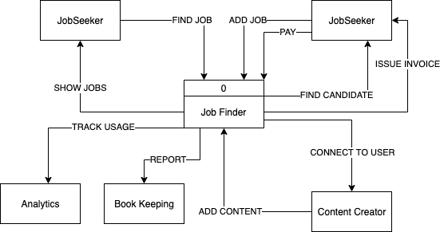
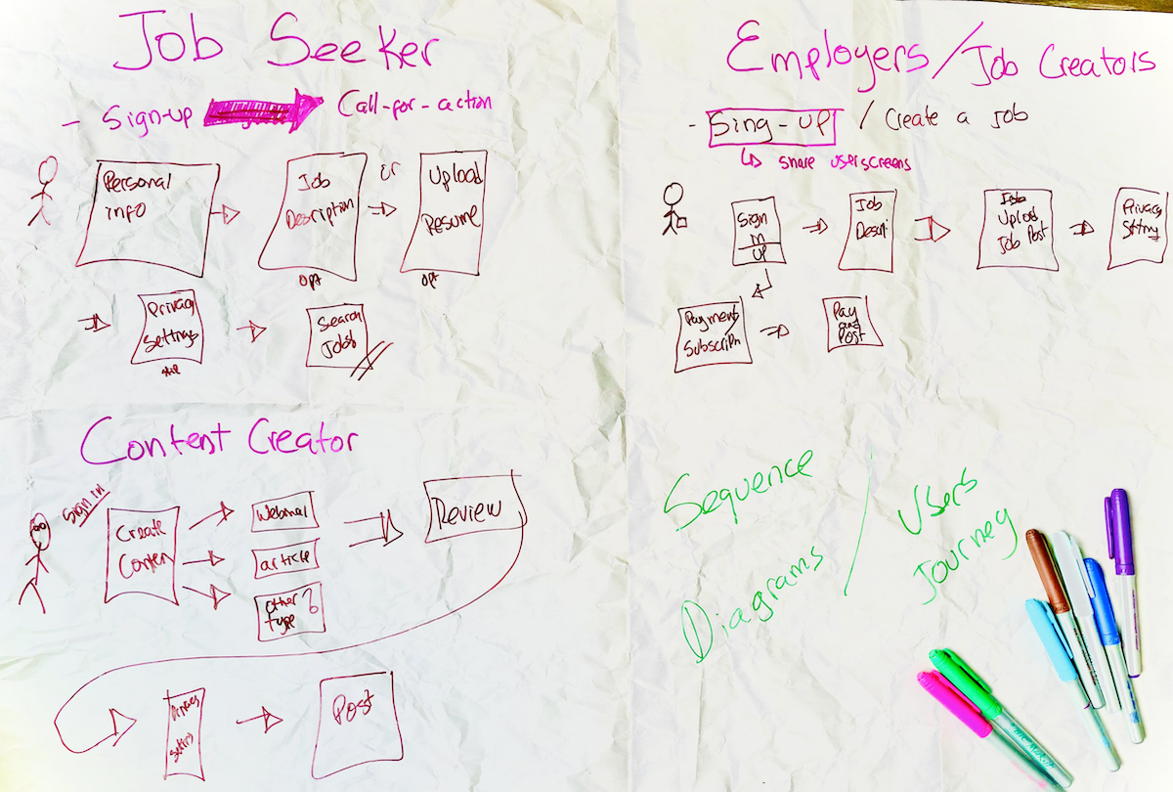
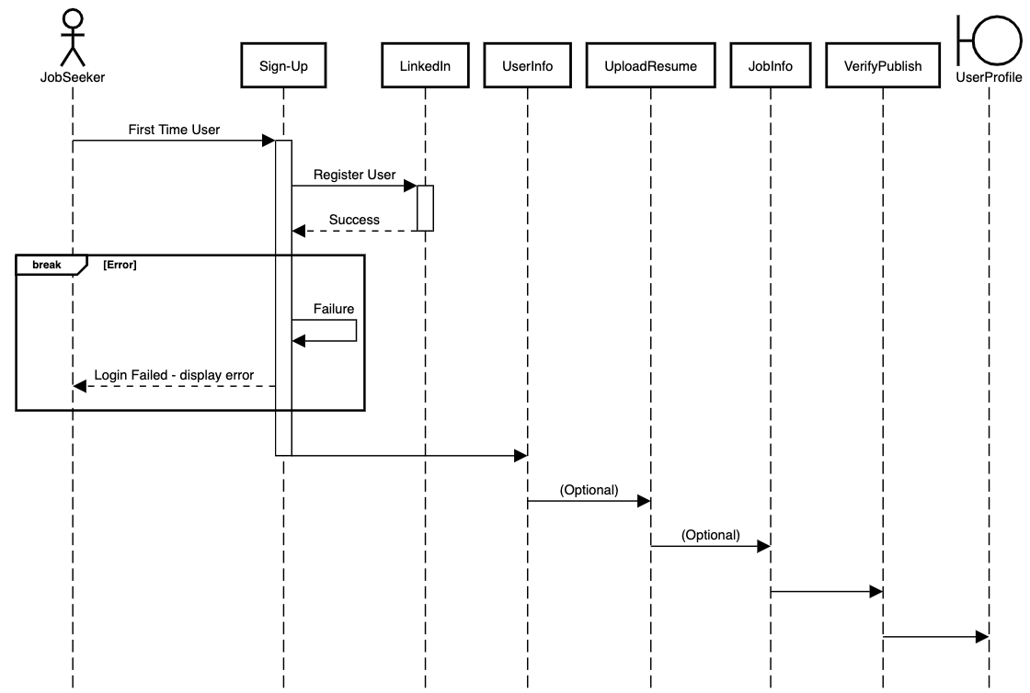
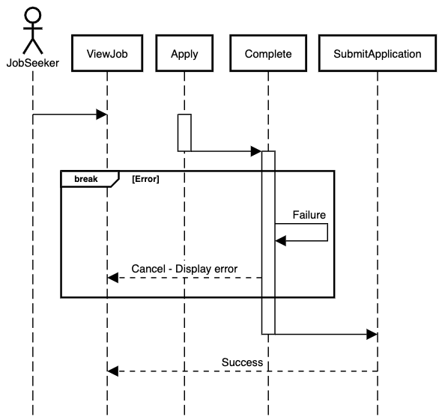
More planning

Slide 6
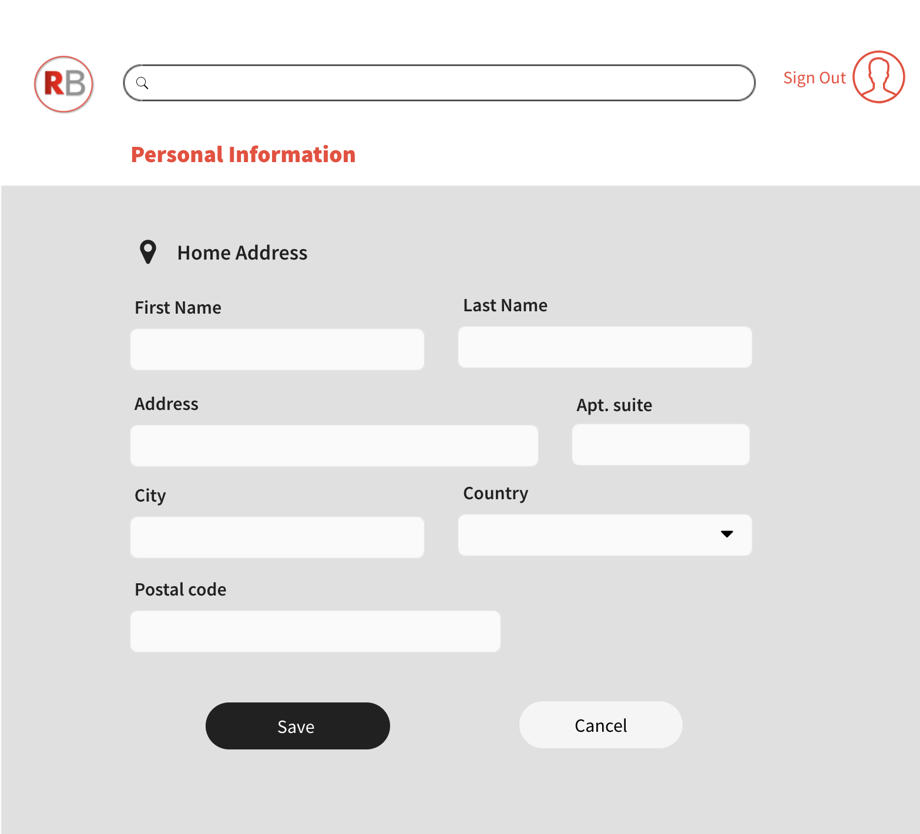
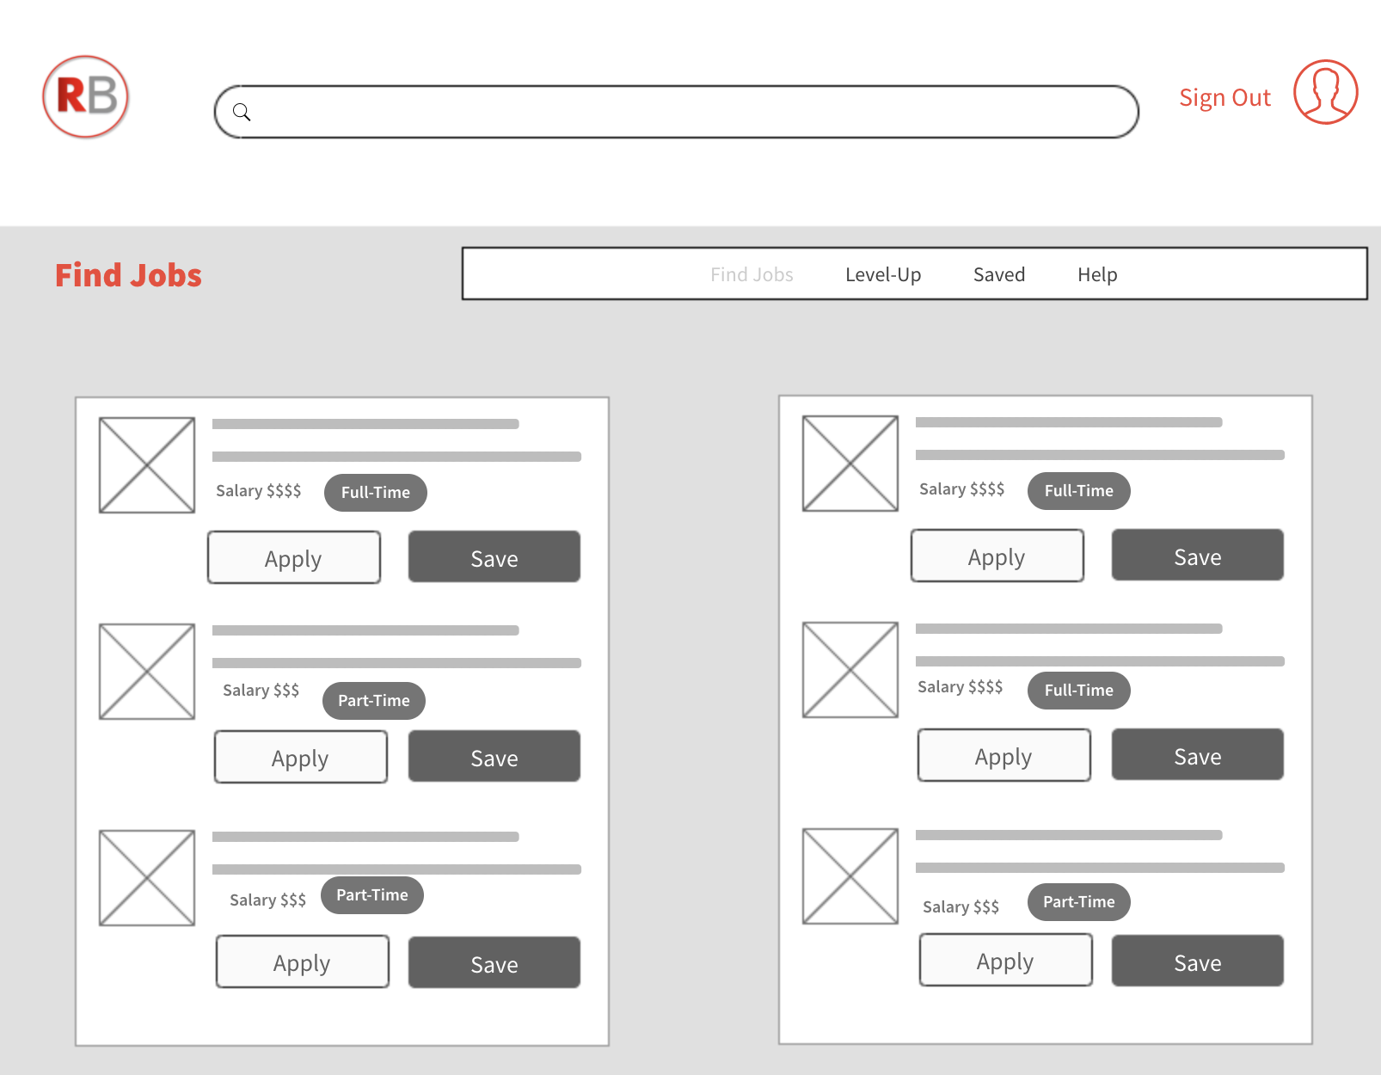
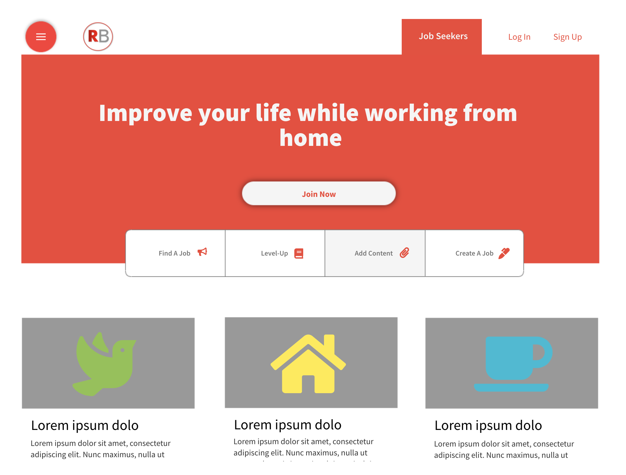
Design

Slide 7
Project Wiki
Home
Design
Diagrams
Architecture Diagram

Slide 8
Tools
Kanban is a framework used to implement agile and it represents the work visually. The board is made up of: visual signals (stickies, tickets, or otherwise), columns, Work In Progress (WIP) limits, commitment points, and delivery points (Atlassian, What is a Kanban Board?).
AppSync is AWS's version of GraphQL as a Service. "AWS AppSync is a fully managed service that makes it easy to develop GraphQL APIs by handling the heavy lifting of securely connecting to data sources like AWS DynamoDB, Lambda, and more." (AWS, AppSync n.d)
Amazon Cognito lets you add user sign-up, sign-in, and access control to your web and mobile apps quickly and easily. (AWS, Cognito, n.d.)

Slide 9
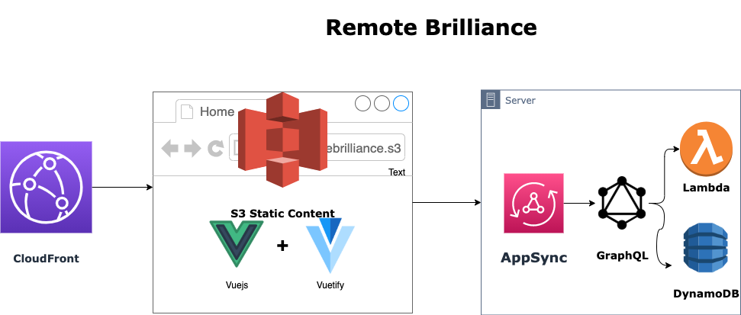
E2E Architecture

Slide 10
Demo

Slide 11
Conclusion
Conducting the research was essential to the success of the project
Apply skills learned overed the last two years at Tiffin and complimenting with my own
Leveraged AWS services to create a secure and reliable application faster
It was a joy working with professor Fritz and everyone at Tiffin.

Slide 12
References
5 facts about the state of the gender pay gap. 5 Facts About the State of the Gender Pay Gap. (n.d.). Retrieved September 25, 2021, from https://blog.dol.gov/2021/03/19/5-facts-about-the-state-of-the-gender-pay-gap.
About indeed. (n.d.). Retrieved September 25, 2021, from https://www.indeed.com/about.
Atlassian. (n.d.). What is a Kanban Board? Atlassian. Retrieved October 6, 2021, from https://www.atlassian.com/agile/kanban/boards.
AWS AppSync. Amazon. (n.d.). Retrieved September 25, 2021, from https://aws.amazon.com/appsync
AWS Cognito (n.d.). Retrieved November 16, 2021, from https://aws.amazon.com/cognito

